Slide 1
Pune institute of computer technology
Project based learning
Project name : Fitness website
Group members:
Sr. No. | Name of Student | Roll No
 | Tejal Kolhe | 10569
 | Akshay Pachkate | 10551
 | Viraj Kakade | 10553
 | Shreya Repale | 10559
 | Parth Deshmukh | 10560

Slide 2
Introduction
How cool is to build your own fitness website like healthifyme.
Our fitness website is a health service that helps individuals attain one of the greatest gifts of all-good health.
Personal gains such as improved self-esteem, self-motivation combined with measurable benefits will create tremendous advantages for the individuals
Our fitness website will provide fitness related information truly dedicated to solving the fitness needs of our costumer.
This will be done through providing the accurate data, providing a clean and crowd-free environment.
It’s not very complicated and can be achieved in HTML, CSS, and java script.

Slide 3
Objectives
To help fitness enthusiast with workout and nutrition information.
To spread awareness about fitness.
To make easy excess of information about fitness.
To help beginner to achieve fitness goal.
To develop a community network for wellness promotion.
Be able to take knowledge that is learned regarding wellness and use it to help others in society
To become motivated to take responsibility for oneself and make positive health behavior changes
To provide physical activity that will enable each person to monitor desired gains.
To provide activities that relieve emotional strain and tension

Slide 4
ABSTRACT
Obesity is a major global challenge. It increases the risk of developing
health problems such as cancer, diabetes and cardiovascular disease.
The use of fitness technology that is fitness websites and apps in supporting health behavior change is promising.
So basically, our website provides information about different exercises, nutrition and calorie, yoga and meditation, etc.
We have created some fitness calculators that make our website interesting.
It contains of a music playlist that consists of songs that keep the user motivated.
All this data is been embedded in the website with the help of HTML.
This information is been made attractive with the help of CSS using different fonts, background images, background colors, templates and lot more.

Slide 5
Stages of Project
Learning stage: we have to learned html ,css, java script to develop fitness website . So we mutually divided this task in group members to perform it efficiently and to ease the process
Stage of Carrying out Research for content : we search for content using online platform. We searched on you tube for explanatory video related to website development and fitness. We used google for diet , picture ,information about exercise and to get data about calories in food items
Stage of built front end website : We developed here basic skeleton of website . We used html to develop the body of the website.
Stage of designing website : We used css for designing website . We can decorate website using text color ,font style , layout design.
Stage of built back end of website : We used java script to design back end of website. We created fitness calculator using this.

Slide 6
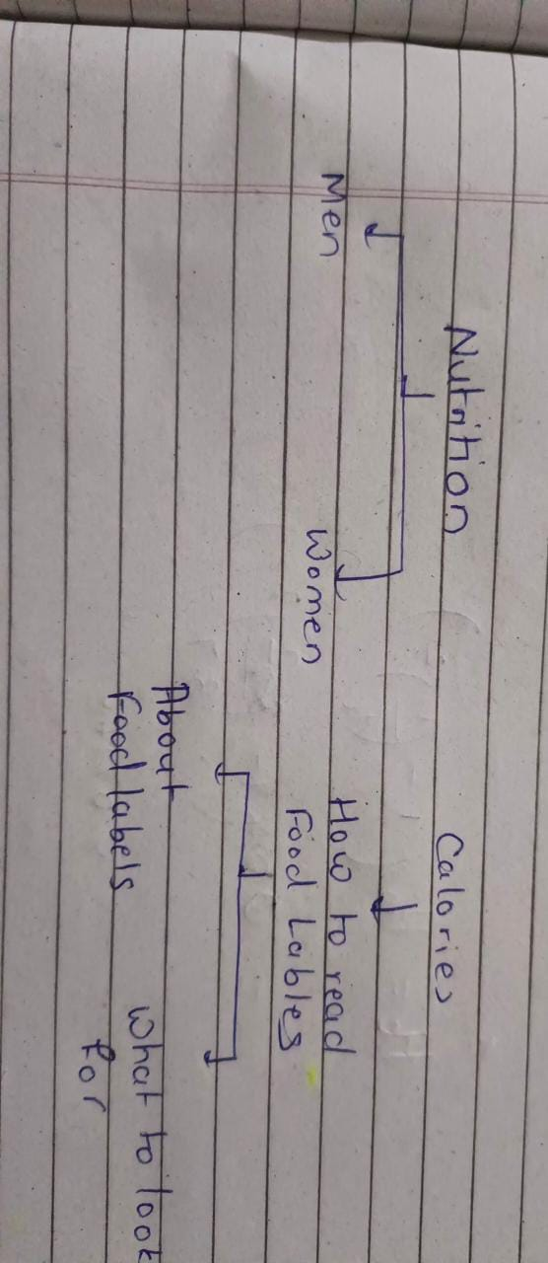
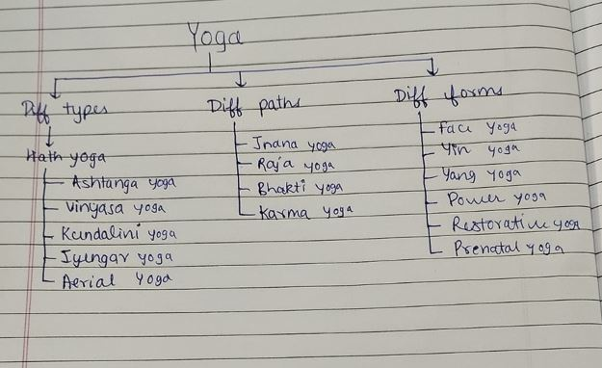
Systematic arrangement of information
A number of flowcharts were made to generalize the
collected information

Slide 7
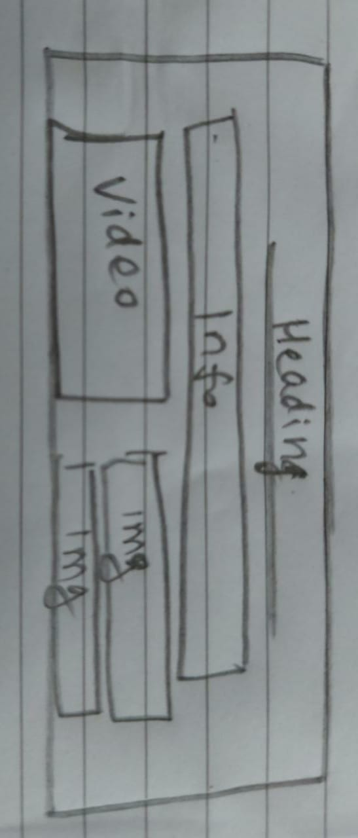
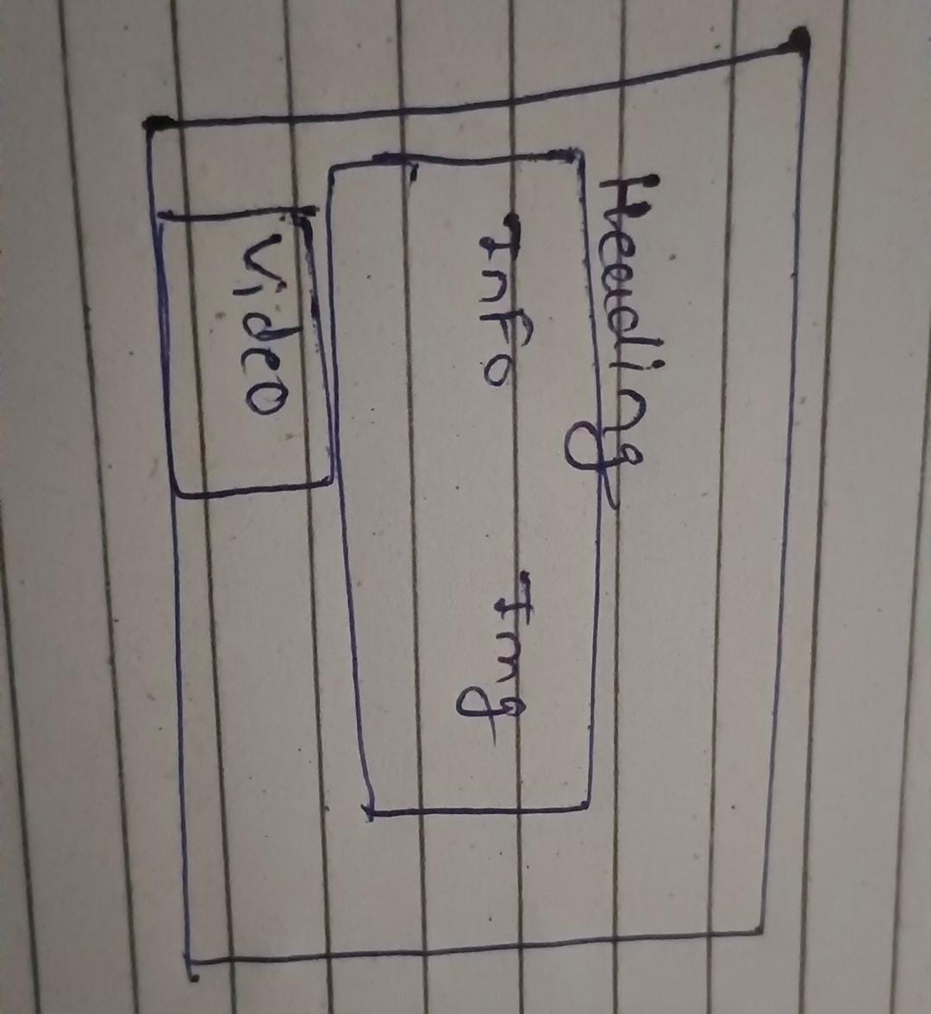
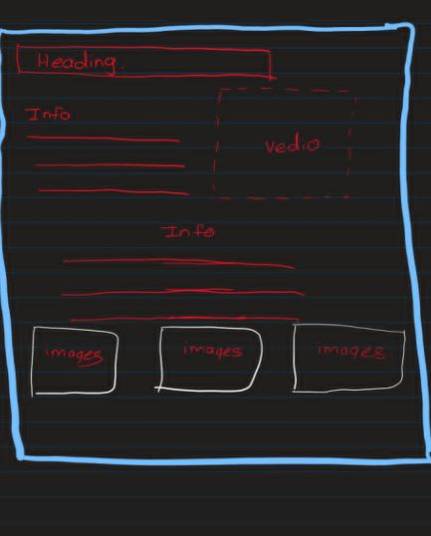
Rough designs for embedding the information and videos
All members created their own styles and some of the designs were selected
for embedding the information and videos.

Slide 8
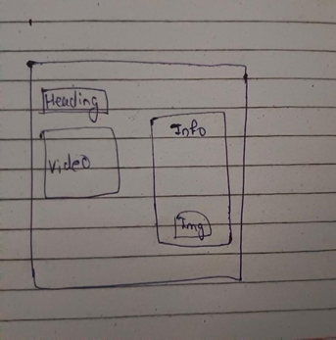
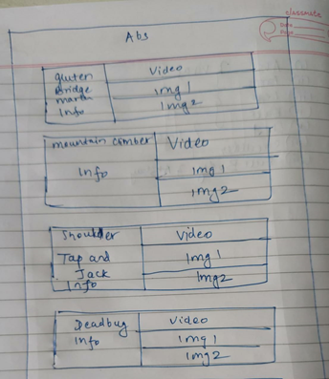
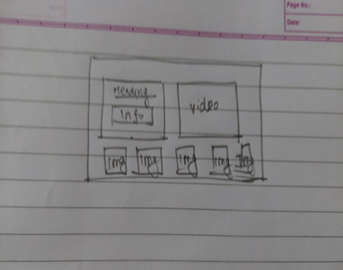

Slide 9
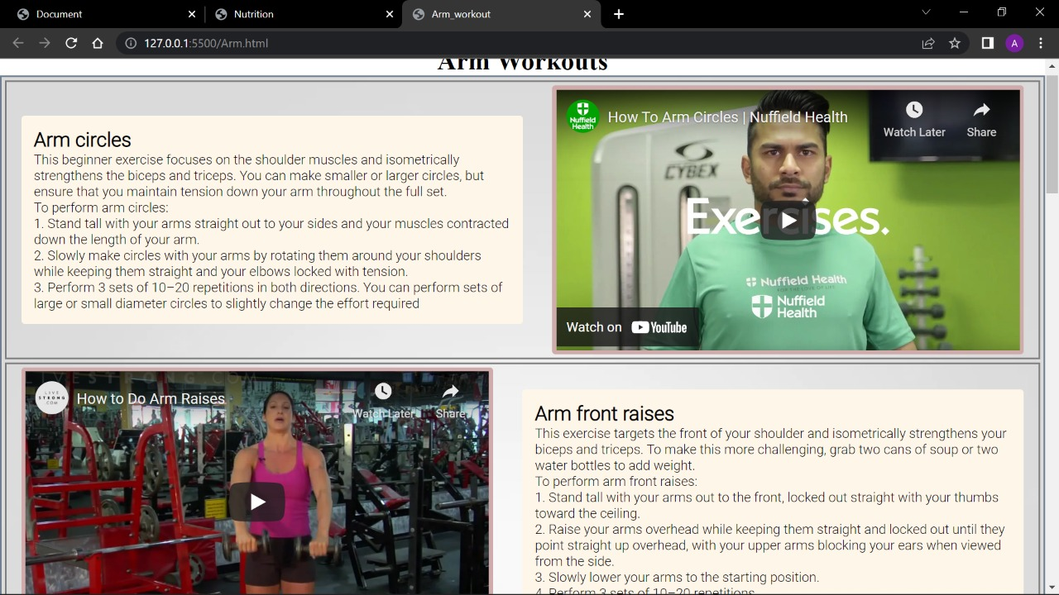
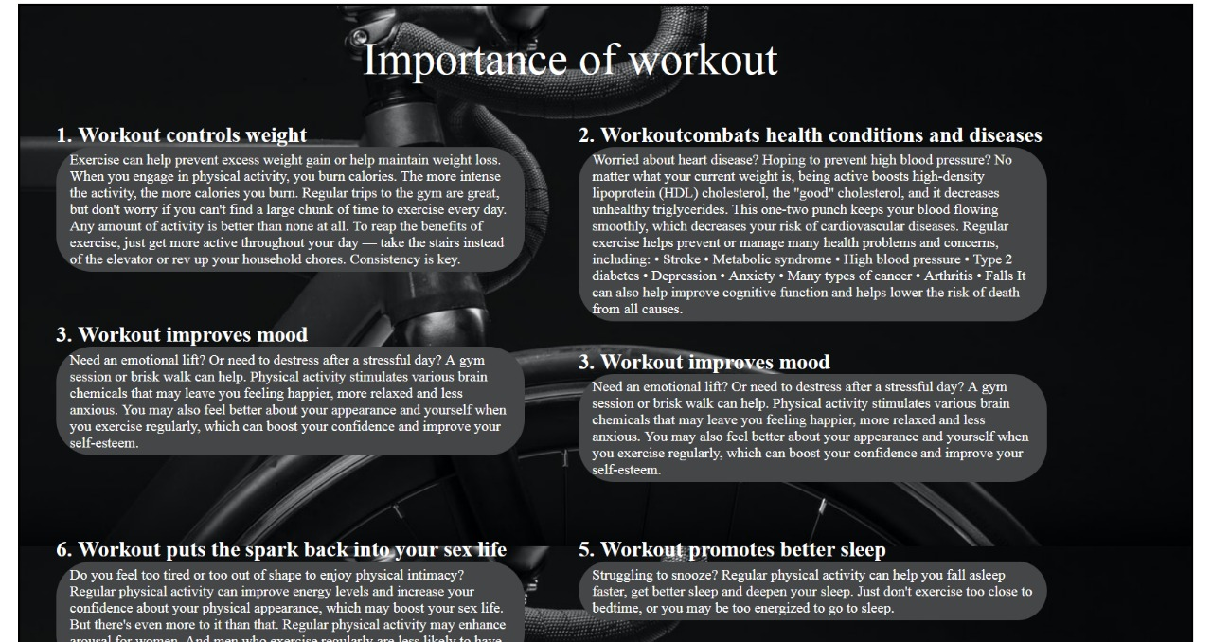
Final designs

Slide 10
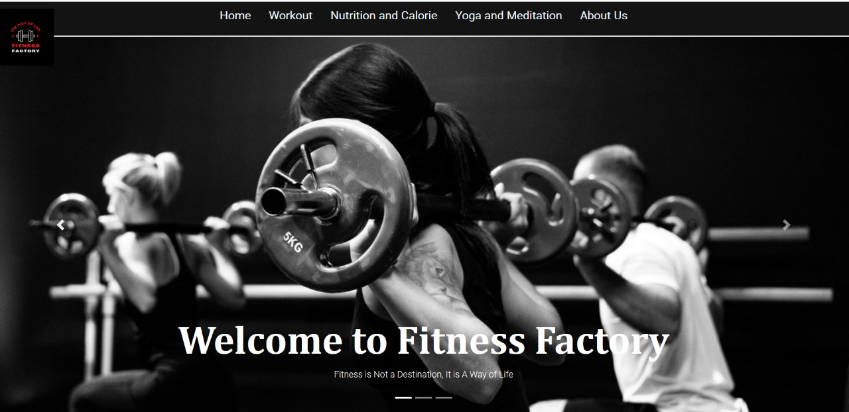
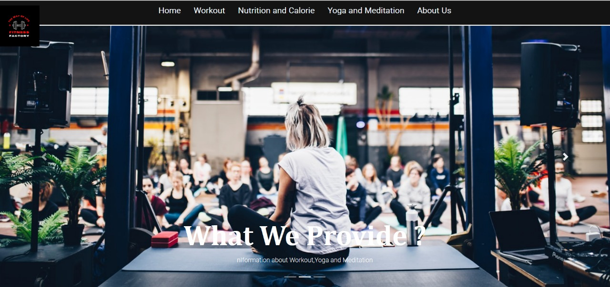
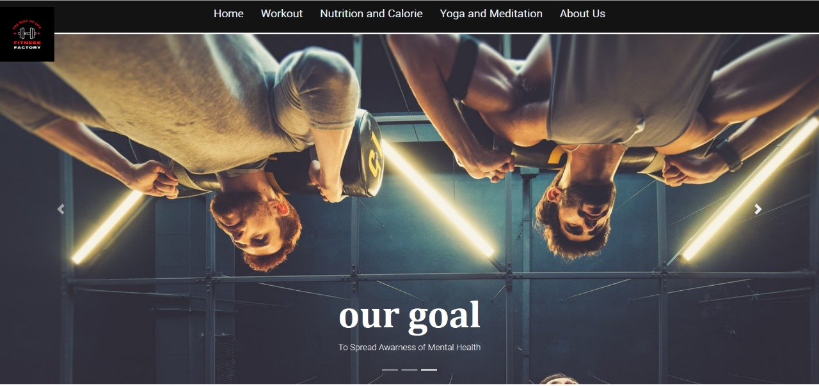
Designing the home page
First of all, the purpose of home page was decided and accordingly the home consists of different sections that can help the user to explore different regions of our website.
It gives the user a basic idea of the website. It tells the user that what we are providing and what is goal of our website.
The home page has a beautiful user interface and is designed in such a way that it attracts the user towards the website.

Slide 11
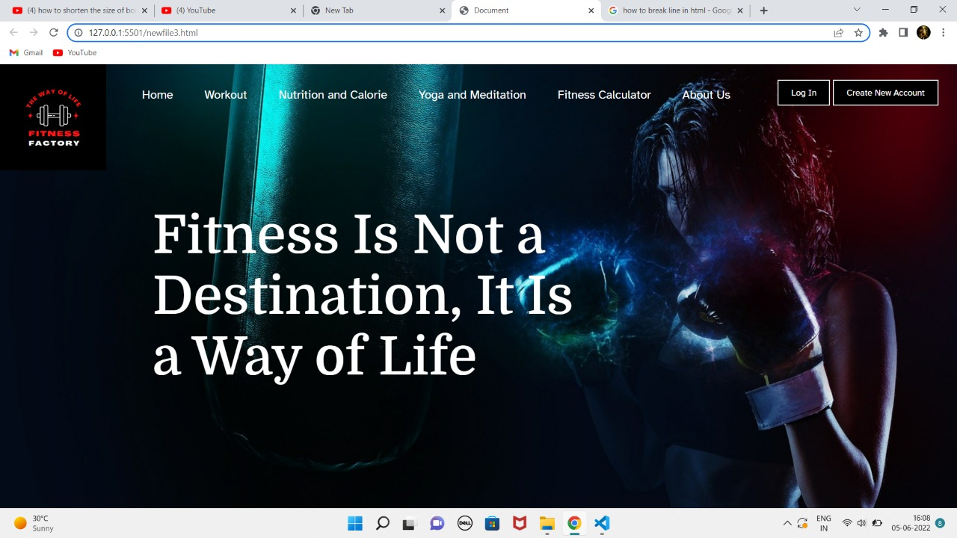
Initial layout
Final layout
Selection of the background image was one of the important decision as it was going to have a
great impact on the perspective of the user towards our website.
So, number of background images were sorted and the best image was selected as the background Image of the home page.

Slide 12
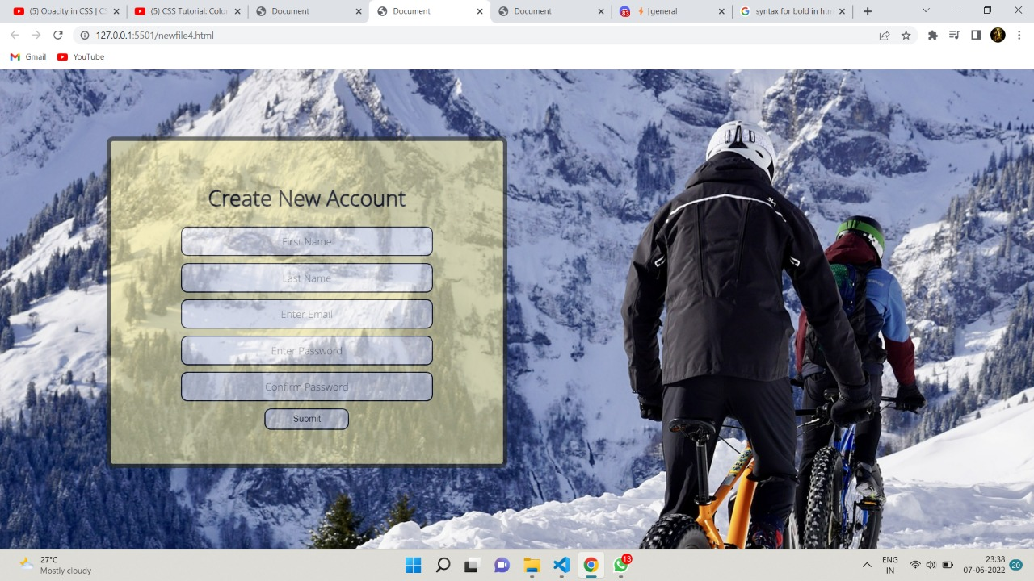
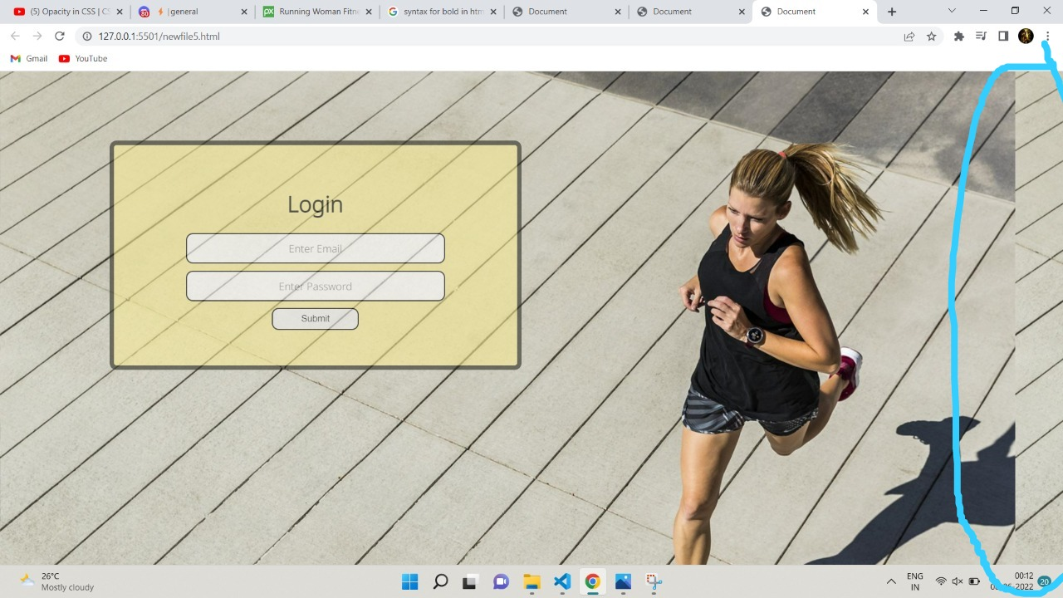
Rejections for the home page
Login page:
There are some websites that allow only those people to access there websites who have already registered in their website but we want everyone to use our website without any registration as are ultimate goal is to provide information to the user

Slide 13
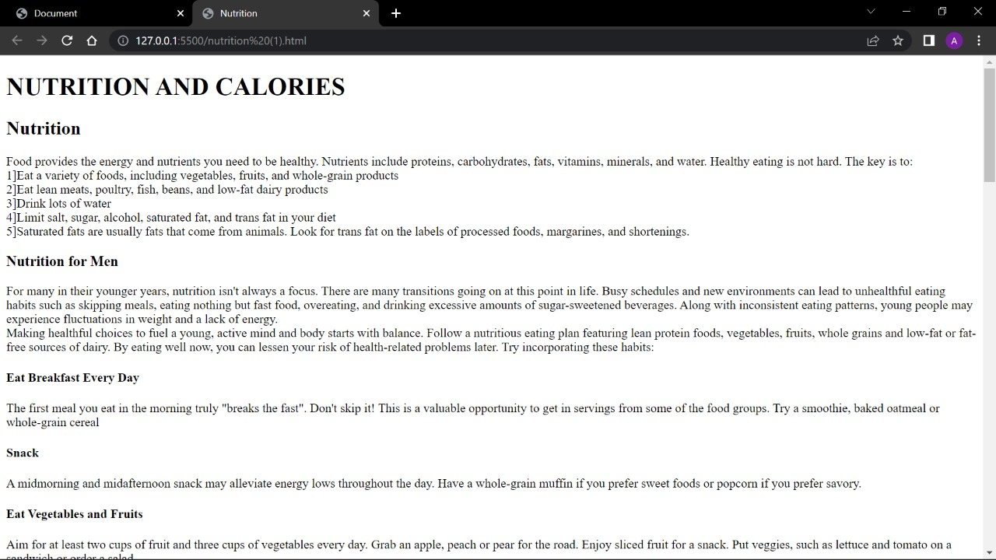
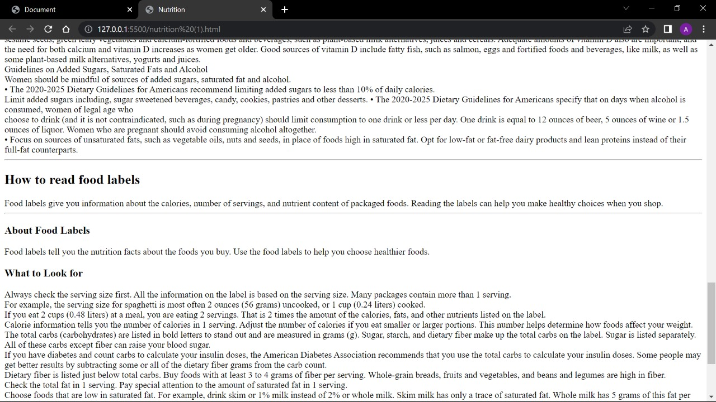
Designing the nutrition page
HTML output

Slide 14
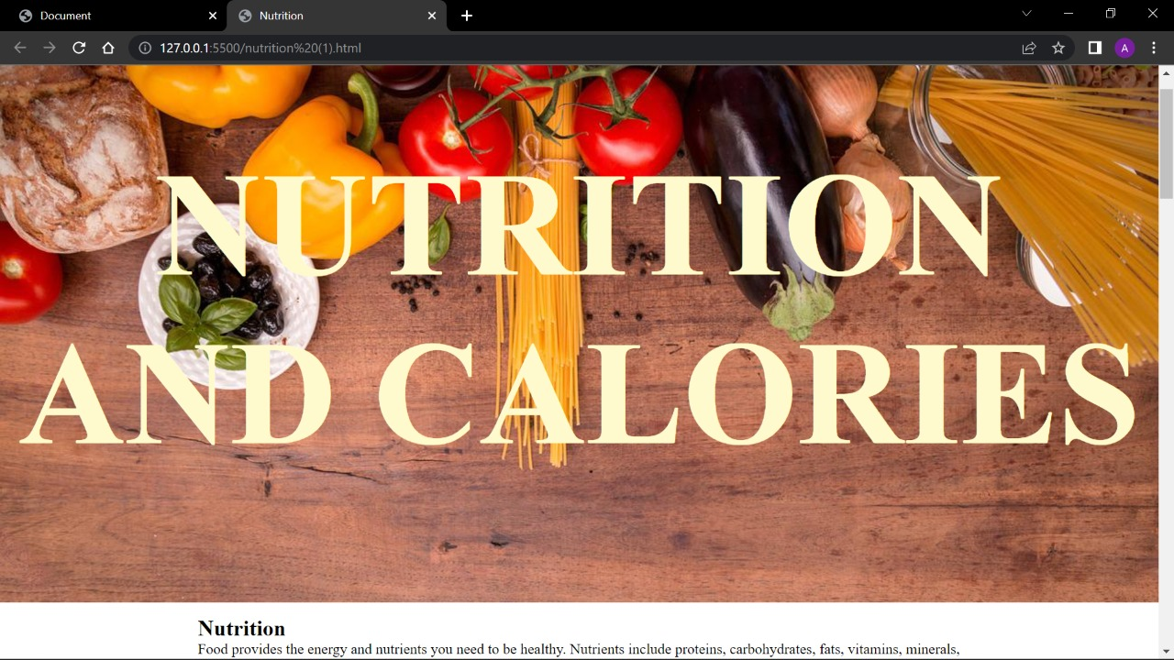
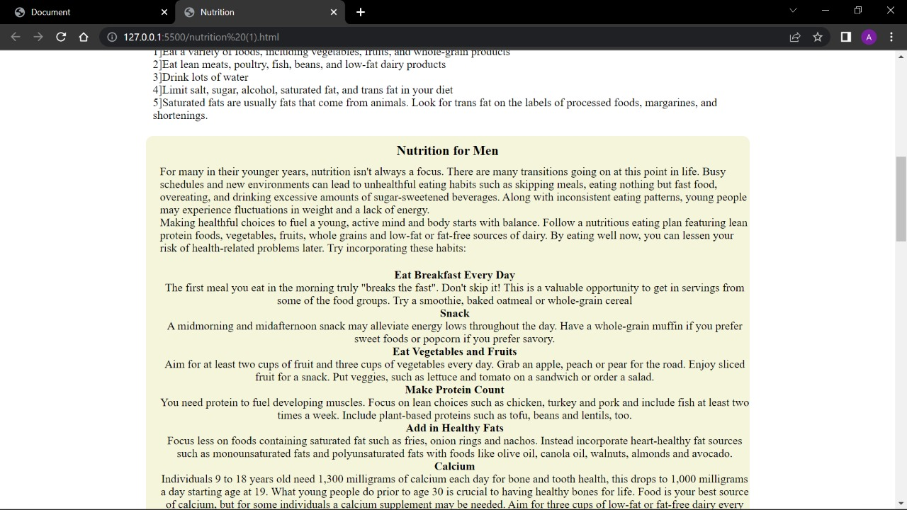
css output:
The use of css made the nutrition page beautiful.

Slide 15
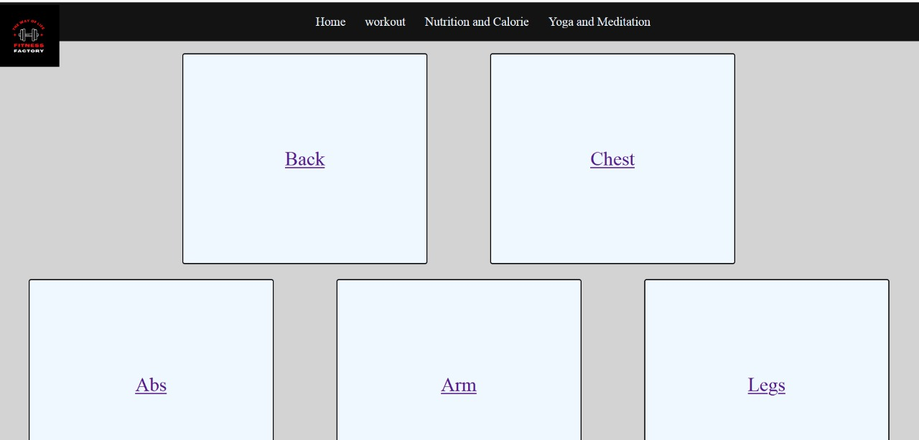
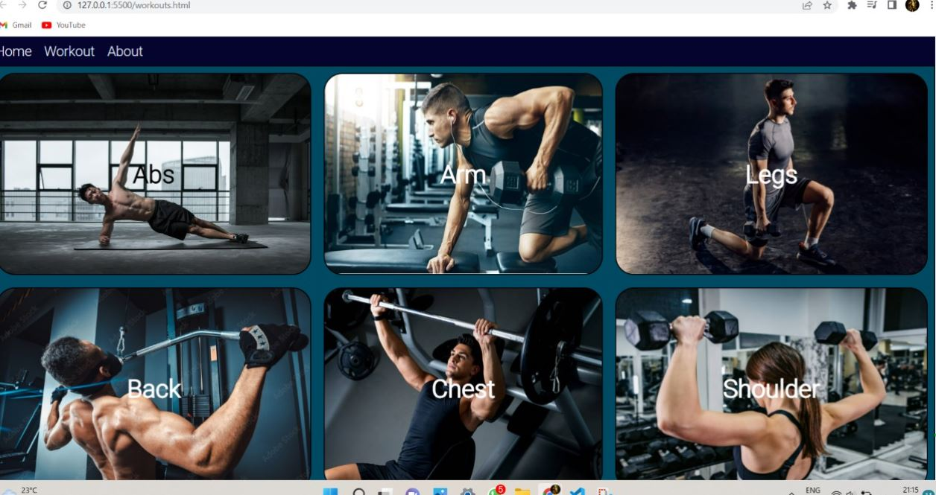
Designing the workout page
This is the interface occurred when the user clicks on the workout section. Different workouts for different parts of the body are been given and as per the interest of user he can access the information.

Slide 16
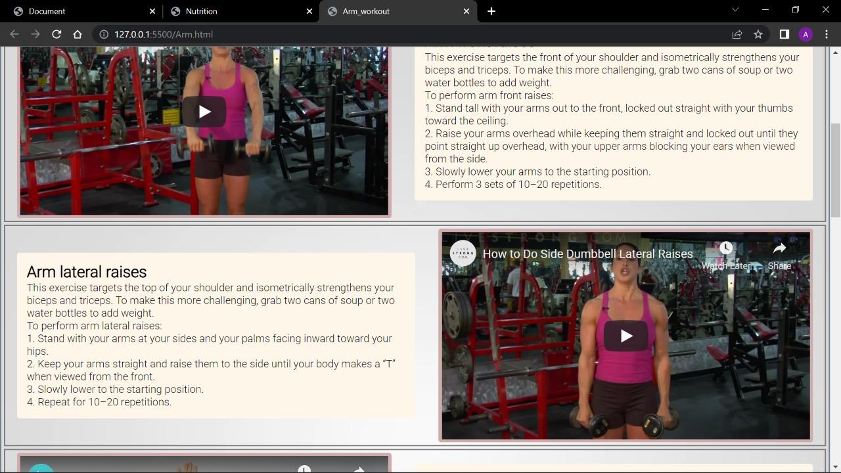
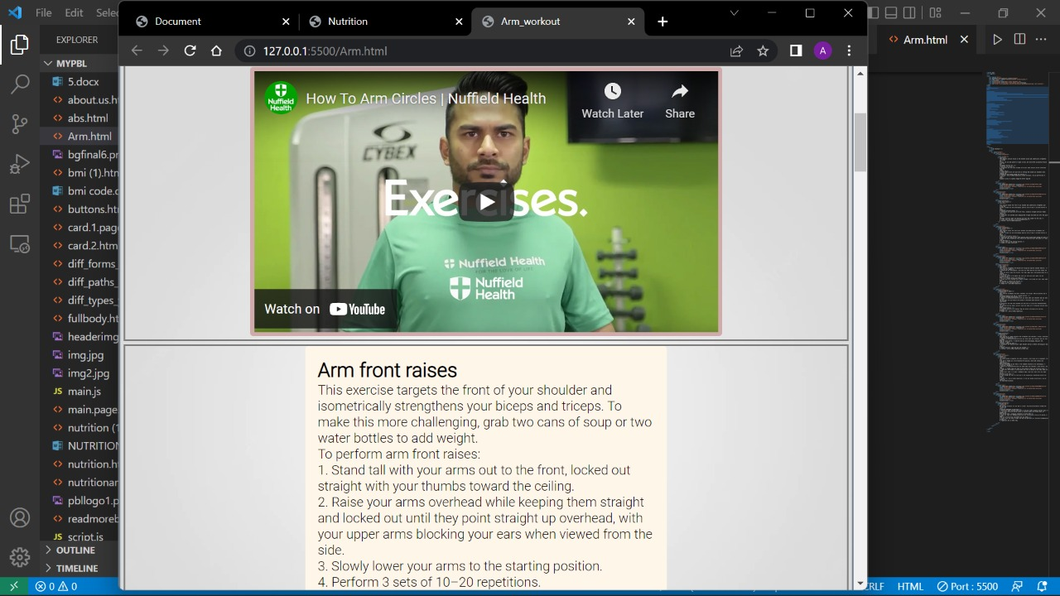
On clicking on any type of workout (for example, here Arm) , we can get access not only to the information but also to the video of the specific
Initially the information and the videos were designed separately and then merged

Slide 17
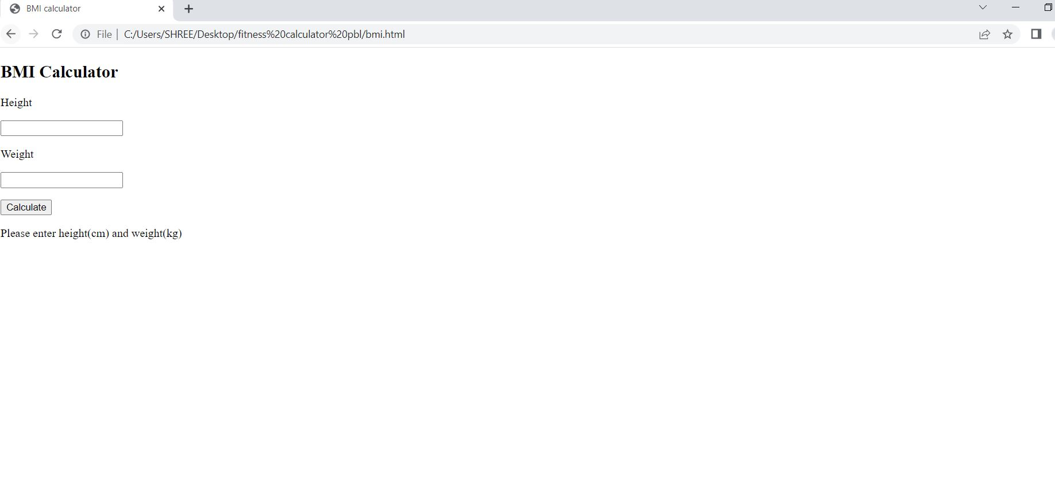
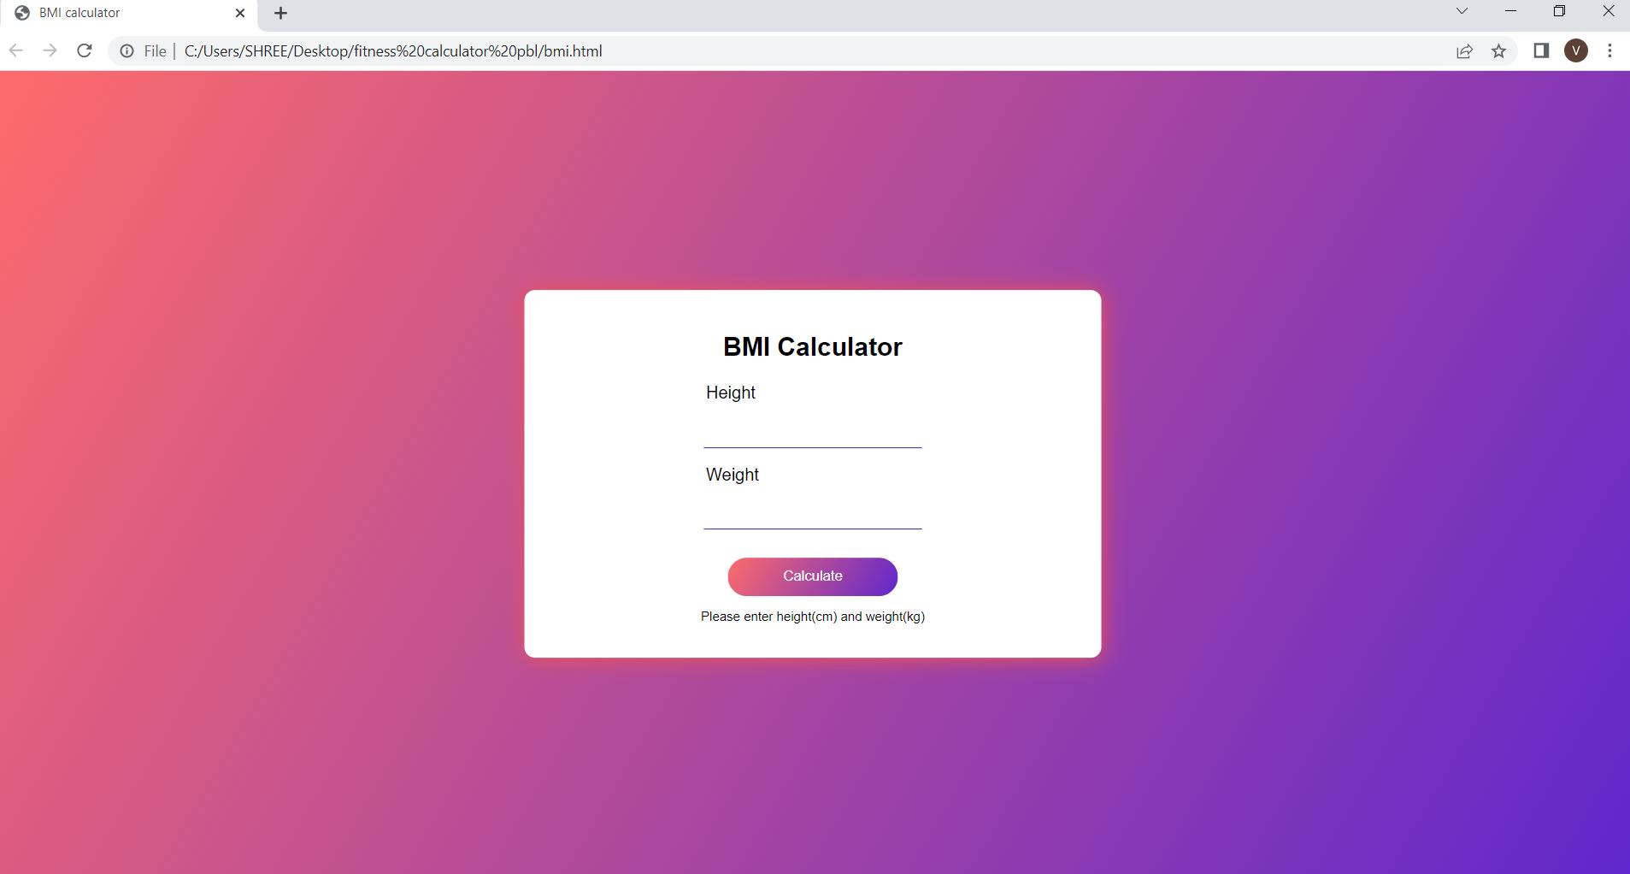
Designing the Fitness calculator
It is made using CSS, HTML and JS. It consists of an ideal weight and a bmi calculator
Initial layout
(using html)
Final layout
(using css)

Slide 18
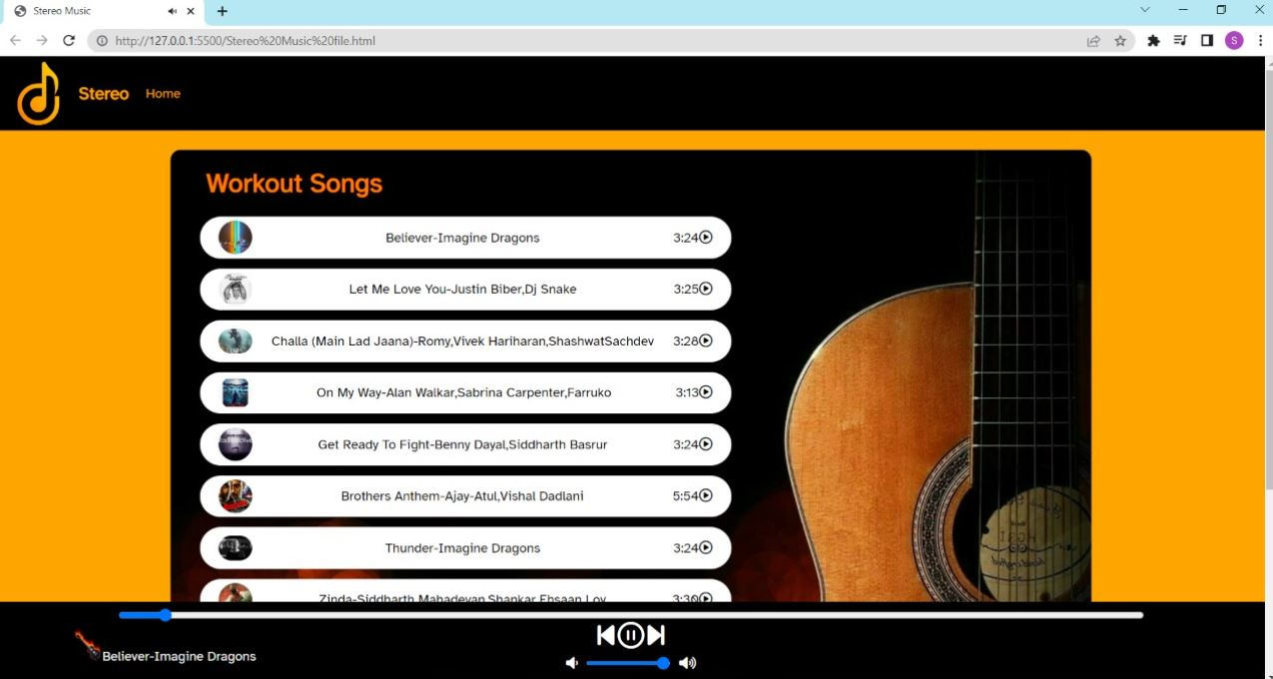
Designing the Music playlist
The users feel weary while carrying out their daily workout routine.
So, we designed the music playlist for keeping our users motivated.
It contains songs that keep the user energetic.

Slide 19
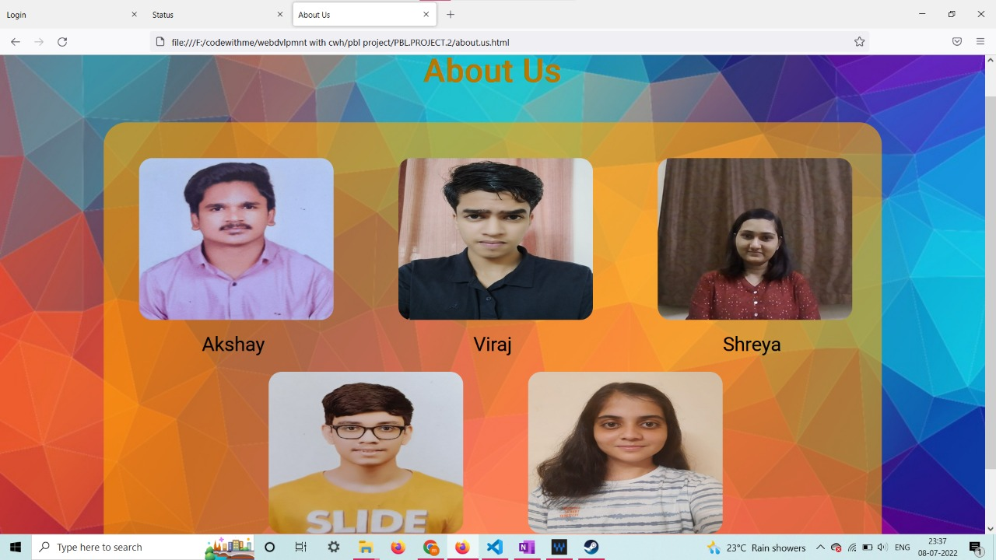
Designing the about us page
It consists the name and photo of the creators of the website.

Slide 20
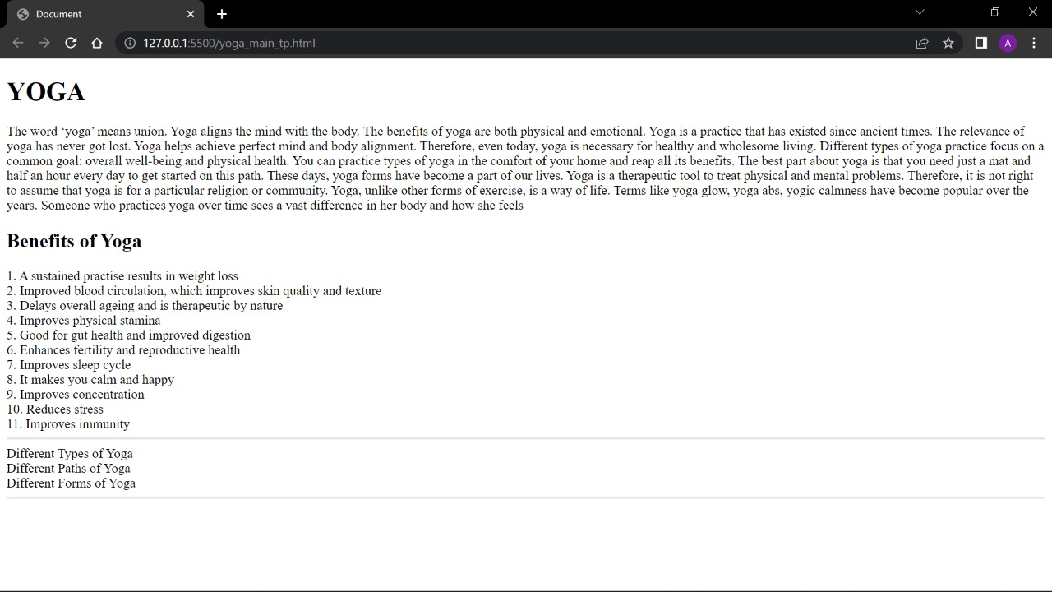
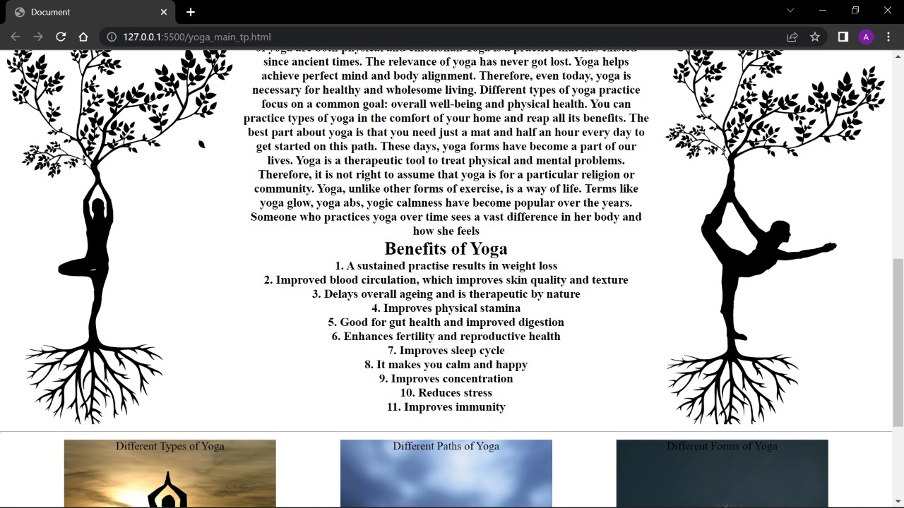
Designing the yoga page
Initially, information about yoga and meditation was inserted using HTML and then was the page was designed in an attractive manner using CSS.
HTML output
css output

Slide 21





Designing the sign of our website:
Many options were created for the design of the sign of website by each member. It was an important decision to select the sign design as it is would represent our website and would be our identity.
Final layout

Slide 22
Conclusion
Obesity is a major issue for health departments all over the world. Despite a great effort, the obesity rate is higher than ever before.
The individuals can be motivated to increase their physical activity through behavioral interventions.
So ultimately our website gives the importance of health and guides the user how to take care of their health.
It contains a home page that gives a brief idea about our website
It contains a section “workout” that allows the user to get access to the information about various exercises.
One section provides important information on nutrition and calorie.
We have embedded some fitness related calculators in a section named “fitness calculators”. One section provides information on yoga and meditation. We have embedded video links that will guide the user to do the following activity.
The “about us” section will give the user the information about the website creators.

Slide 23
Reference links
These are the following sources that we referred to:
For information:
https://www.healthifyme.com/in/
https://www.articlecity.com/
https://www.fitnessblender.com/
https://www.livestrong.com/
https://www.articlecity.com/
For images:
https://pixabay.com/
For videos:
Youtube links
https://www.youtube.com/c/howcast/
https://www.youtube.com/c/nuffieldhealth/
https://www.youtube.com/c/nuffieldhealth/

